Slide 1
Change – I need a change
Basic 07 – Unit 9a

Slide 2
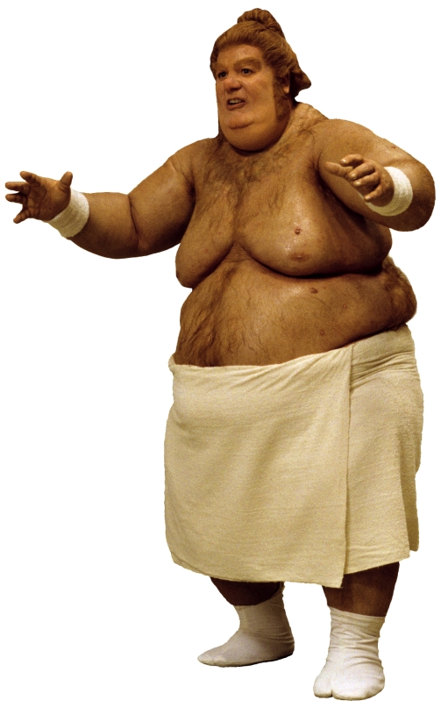
What should he change to feel better?
He eats a lot of junk food, he smokes, he doesn’t exercise and he likes to sleep a lot.
I think he should….

Slide 3
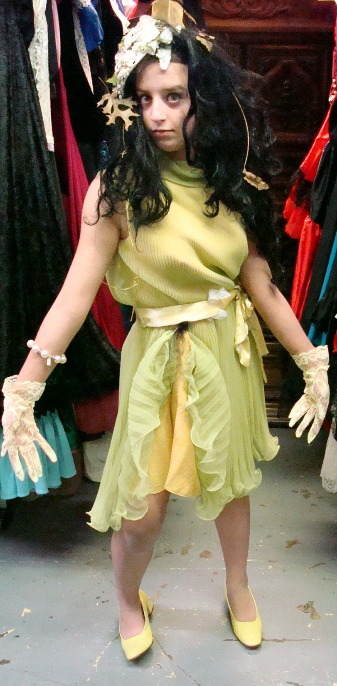
What should she change?
She is very shy, she never brushes her hair, she likes to buy expensive designer clothes, and she has a lot of debts in her credit cards ☹
I think she should….

Slide 4
Changes in Life

Slide 5
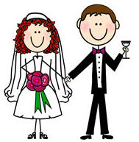
Get married

Slide 6
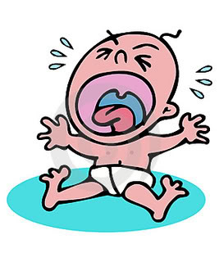
Have a baby

Slide 7
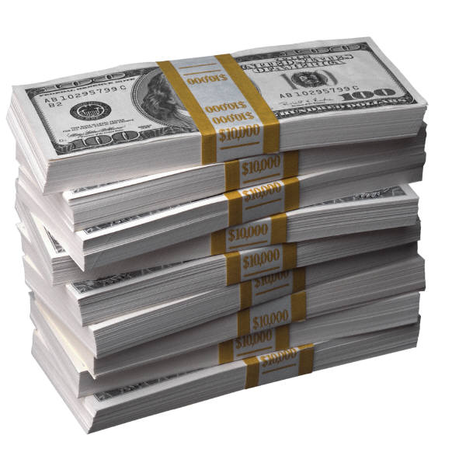
Get a promotion at work and make more money

Slide 8
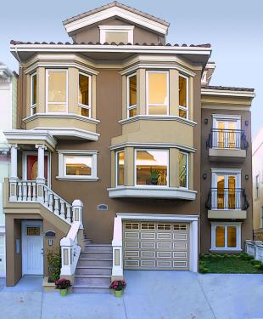
Buy a house / get a new house

Slide 9
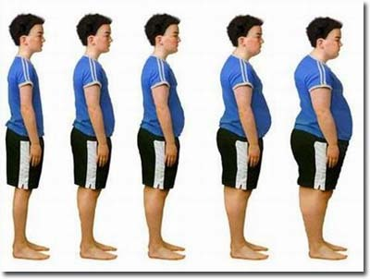
Gain weight

Slide 10
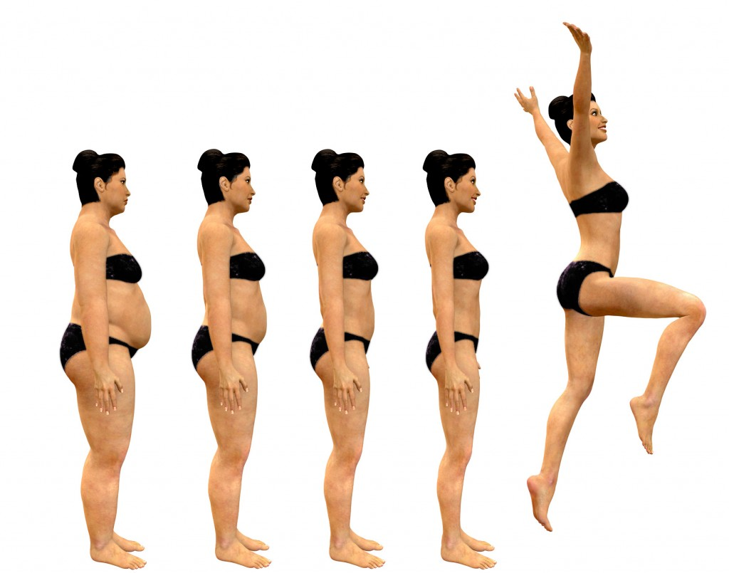
lose weight

Slide 11
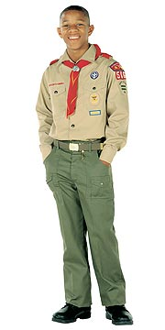



What is one group or club you want to join? Why?

Slide 12

Listening: Another year is over
Many people make changes at the New Year.
What is one change you tried in the past?
One change I tried was to exercise more, but it didn´t happen. ☹

